Slide 1

Cardio Catch Diseases Henrique Issamu Umeda - 2021

Slide 2
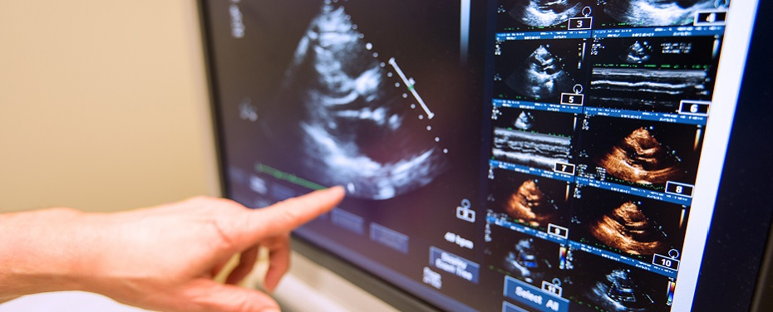
Cardio Catch Diseases
Company specialized in detecting early-stages cardiovascular diseases (CVD)

Slide 3
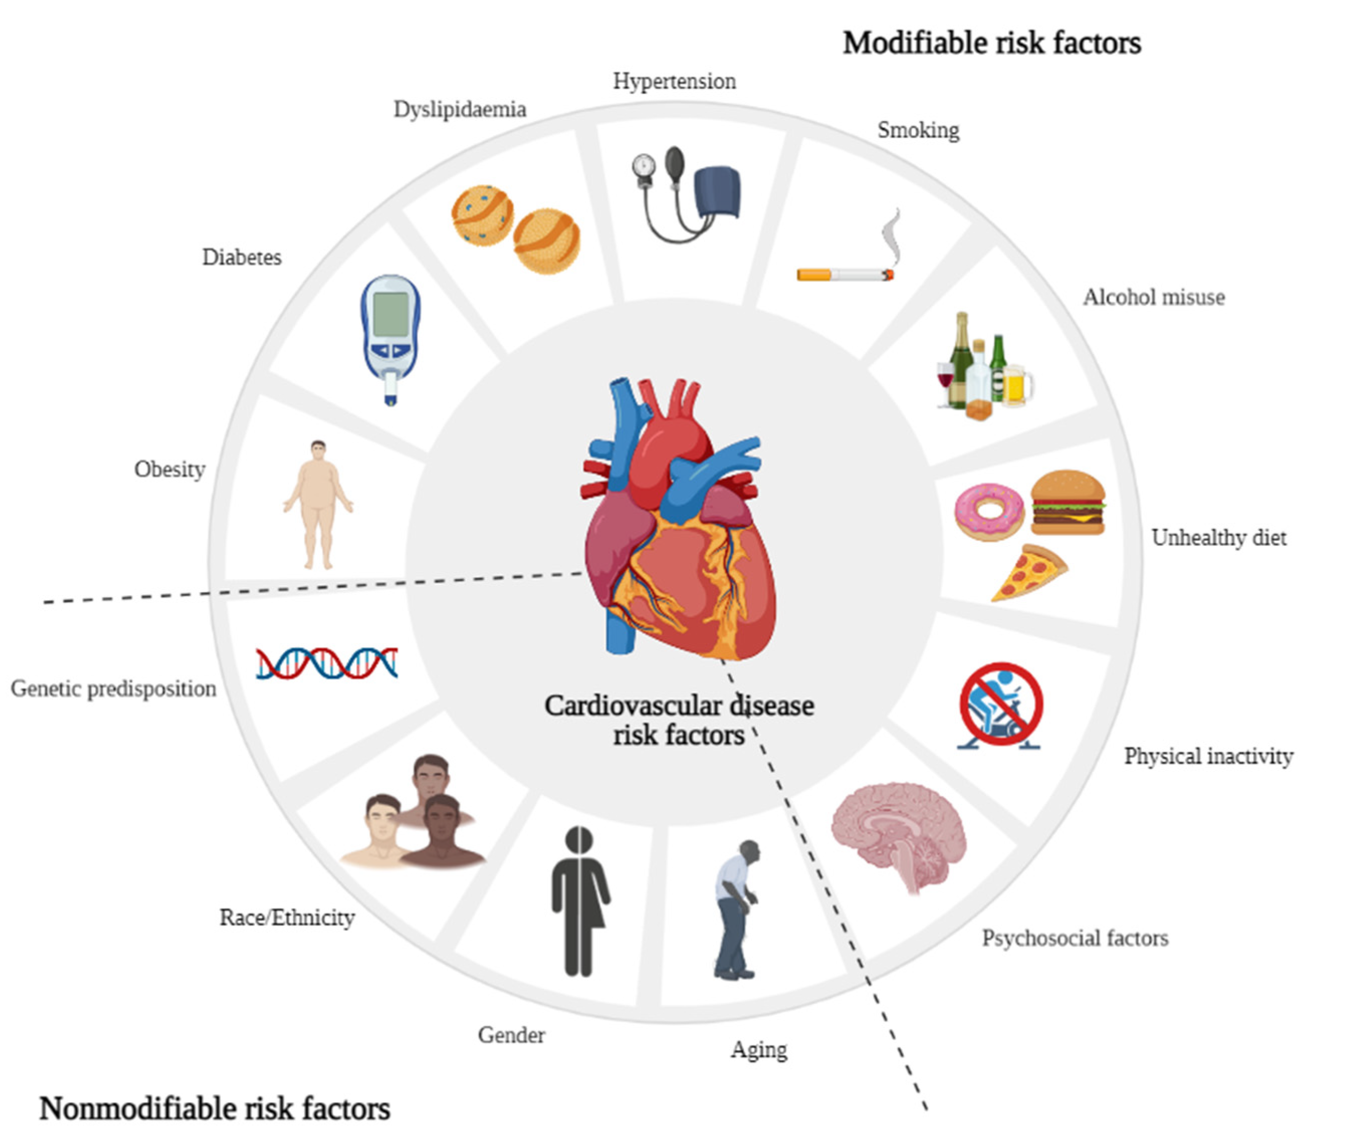
CVD Risk Factors
Molecules | Free Full-Text | The Role of Essential Oils and Their Main Compounds in the Management of Cardiovascular Disease Risk Factors (mdpi.com)

Slide 4
Current Diagnoses
Type
Cost
Precision
Price
Manual
R$ 1,000.00 per diagnosis
Between 55% and 65%
R$ 500.00 for every 5% of precision above 50%

Slide 5
Objectives
1
2
3
Automate the diagnosis
Increase the precision of the diagnosis
Stabilize the diagnosis precision at above 65% (profitable)

Slide 6
Proposed Solution
Analyze the current given diagnoses data
Create hypotheses to explain why a patient will or won’t have a CVD with the company’s data
Validate or refute each hypothesis with data analysis
Create a Machine Learning model to predict whether or not the patient will have a CVD

Slide 7
Cardio Catch Diseases Data
70,000 given diagnoses (68,743 diagnoses without typos)
12 features
Age
Height
Weight
Gender
Systolic blood pressure
Diastolic blood pressure
Cholesterol
Glucose
Smoking
Alcohol intake
Physical activity
Presence or absence of cardiovascular disease

Slide 8
Hypotheses
People with high blood pressure (hypertension) are more likely to have/develop CVD
People that smokes are more likely to have/develop CVD
People with high cholesterol are more likely to have/develop CVD
People with high glucose levels (diabetes) are more likely to have/develop CVD
People that doesn't exercise regularly are more likely to have/develop CVD
People with higher Body Mass Index (overweight and obese) are more likely to have/develop CVD
Older people are more likely to have/develop CVD
Men are more likely to have/develop CVD
People that drinks alcohol are more likely to have/develop CV

Slide 9
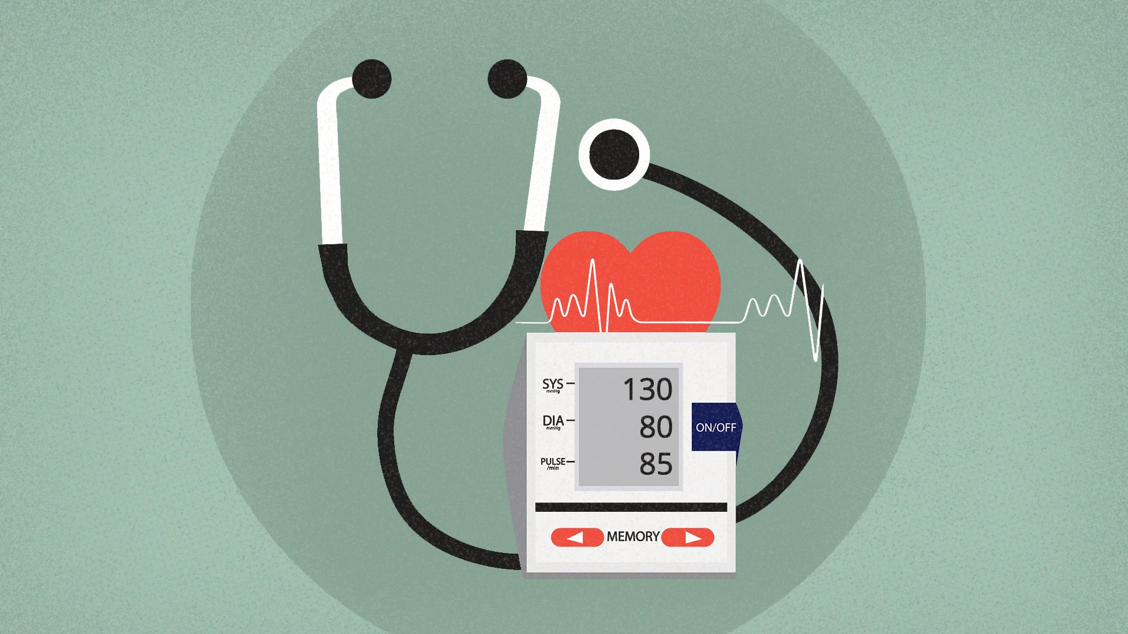
Hypertension

Slide 10
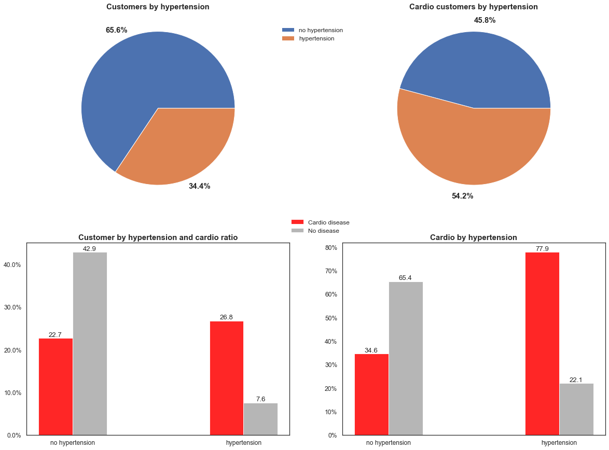

Slide 11
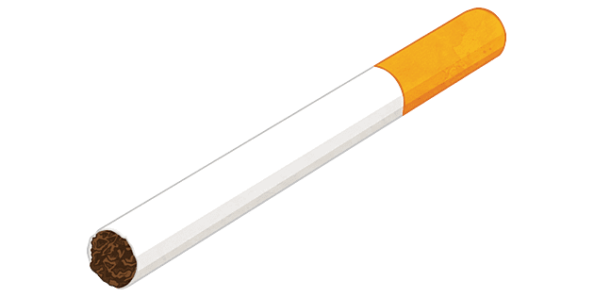
Smoking

Slide 12
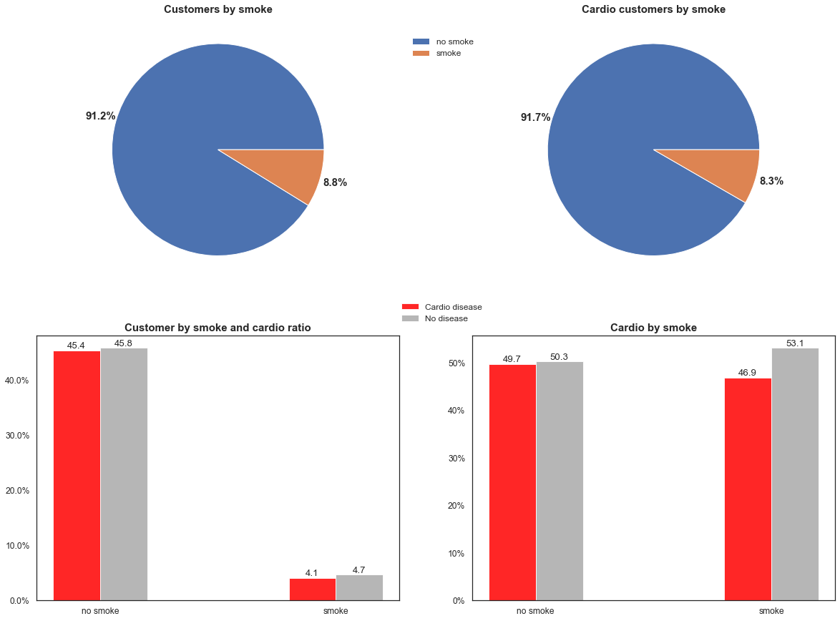

Slide 13
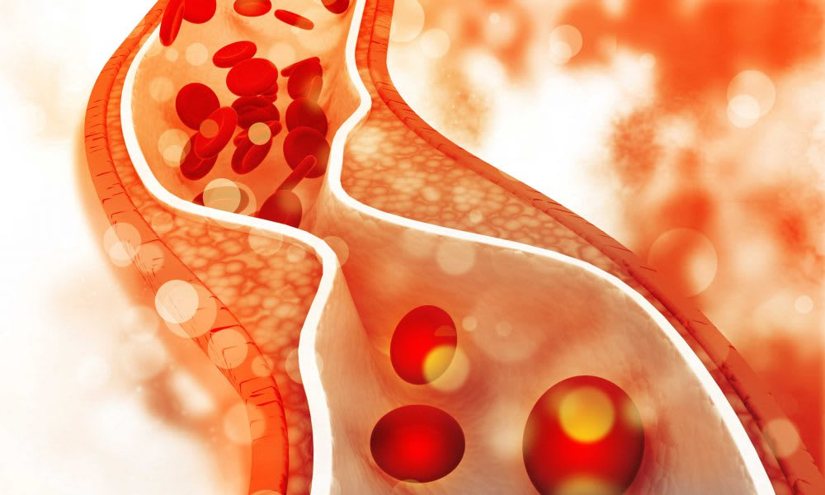
Dyslipidemia (Cholesterol)

Slide 14
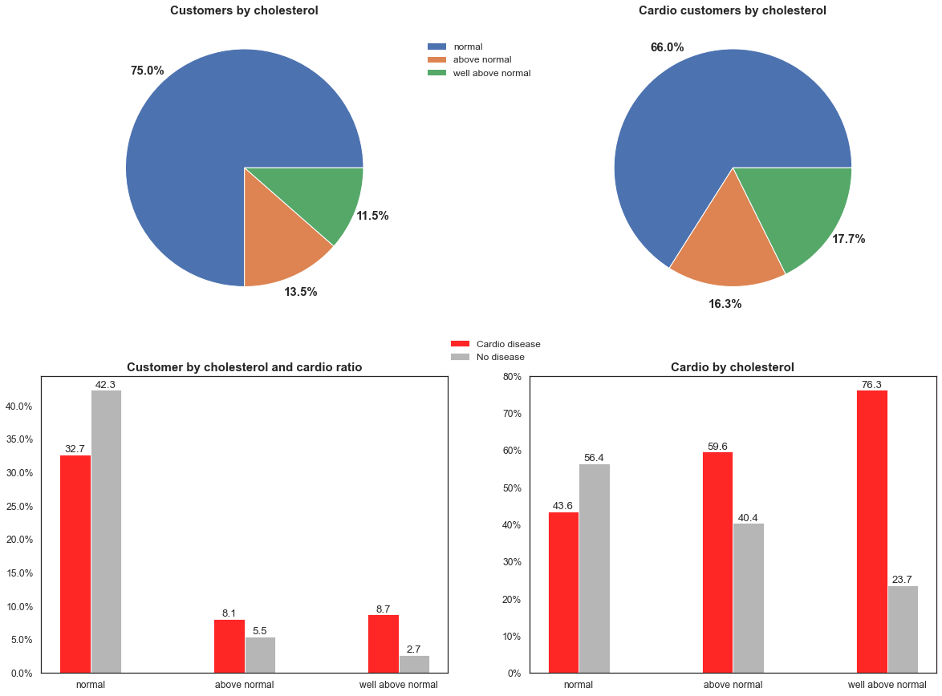

Slide 15
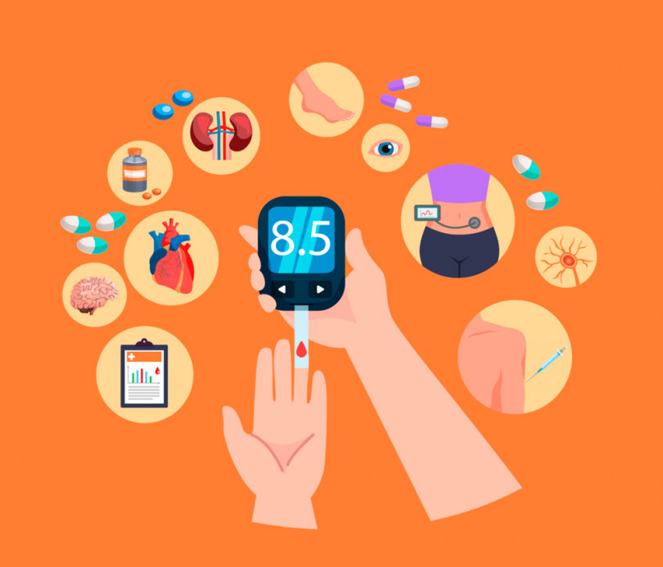
Diabetes (glucose)

Slide 16
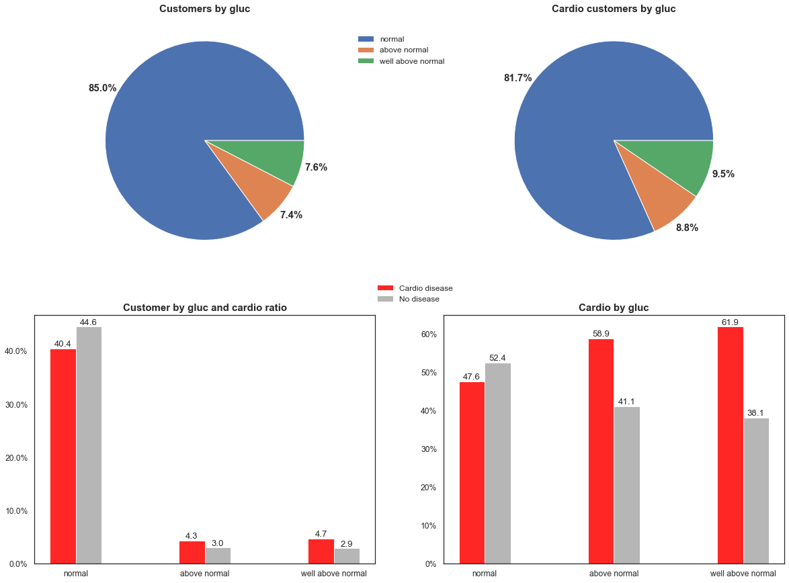

Slide 17

Physical Inactivity

Slide 18
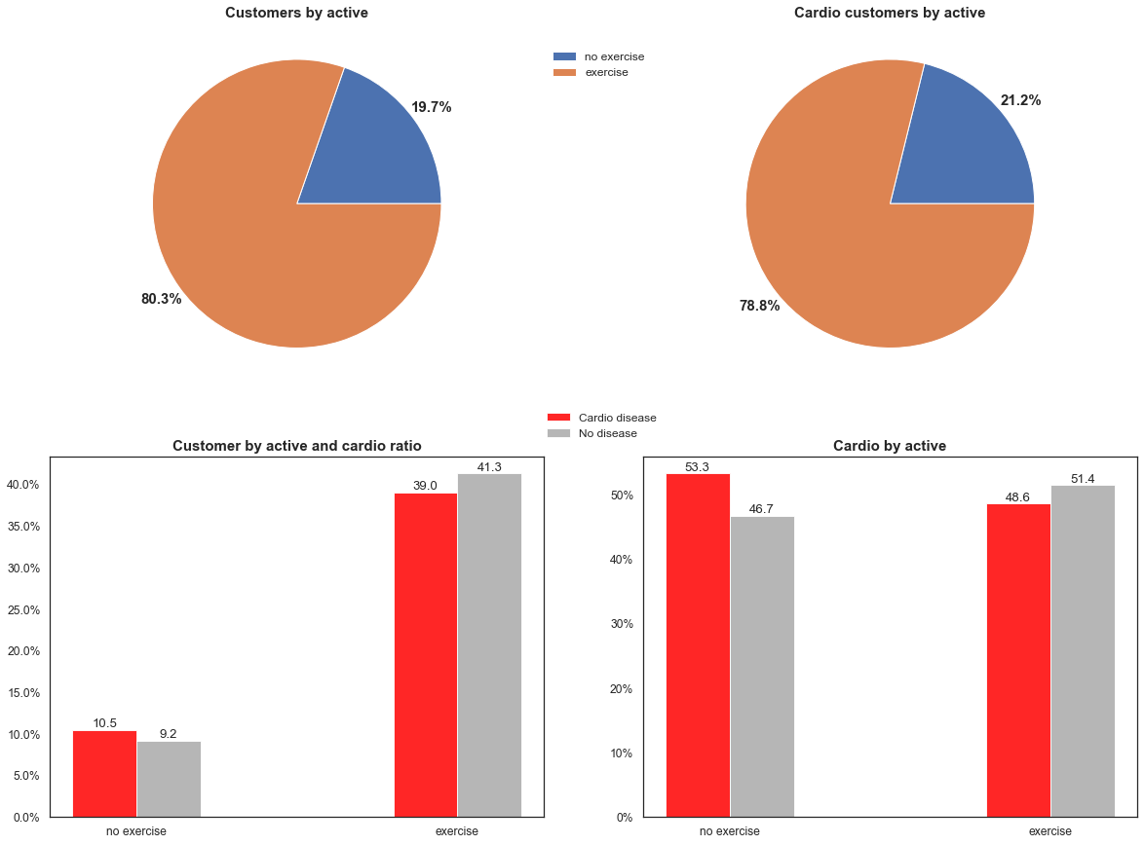

Slide 19
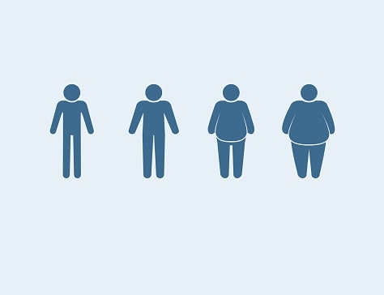
Body Mass Index

Slide 20
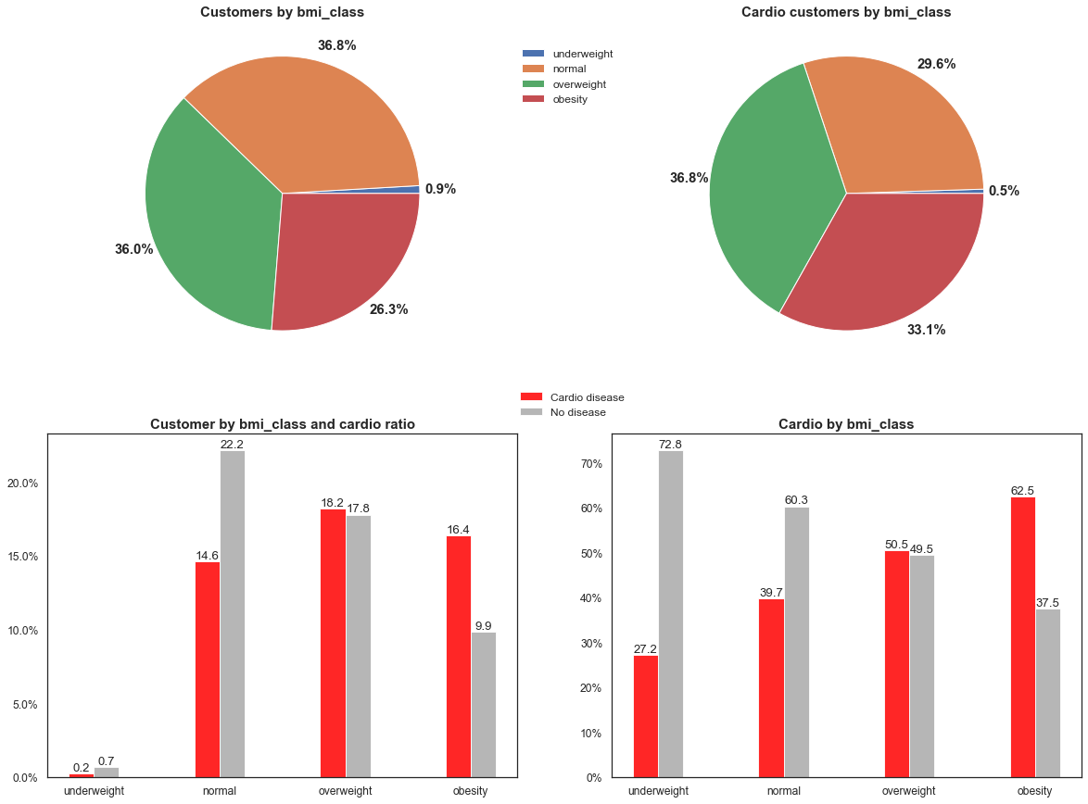

Slide 21
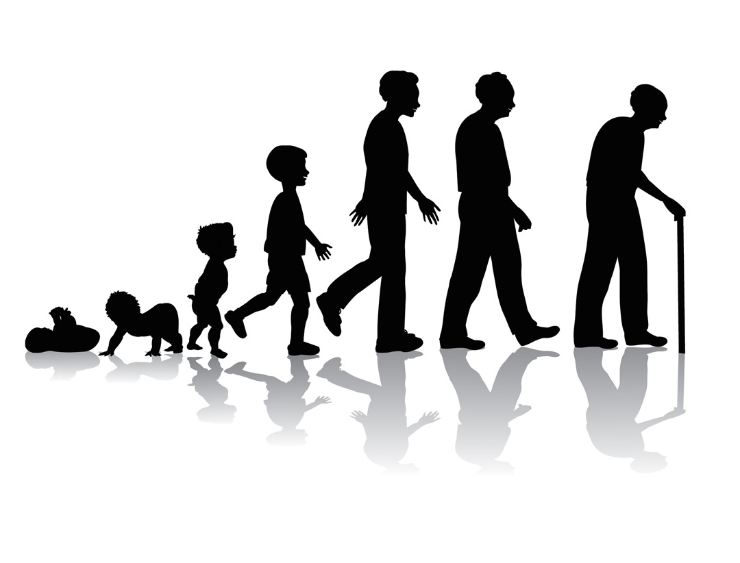
Age

Slide 22
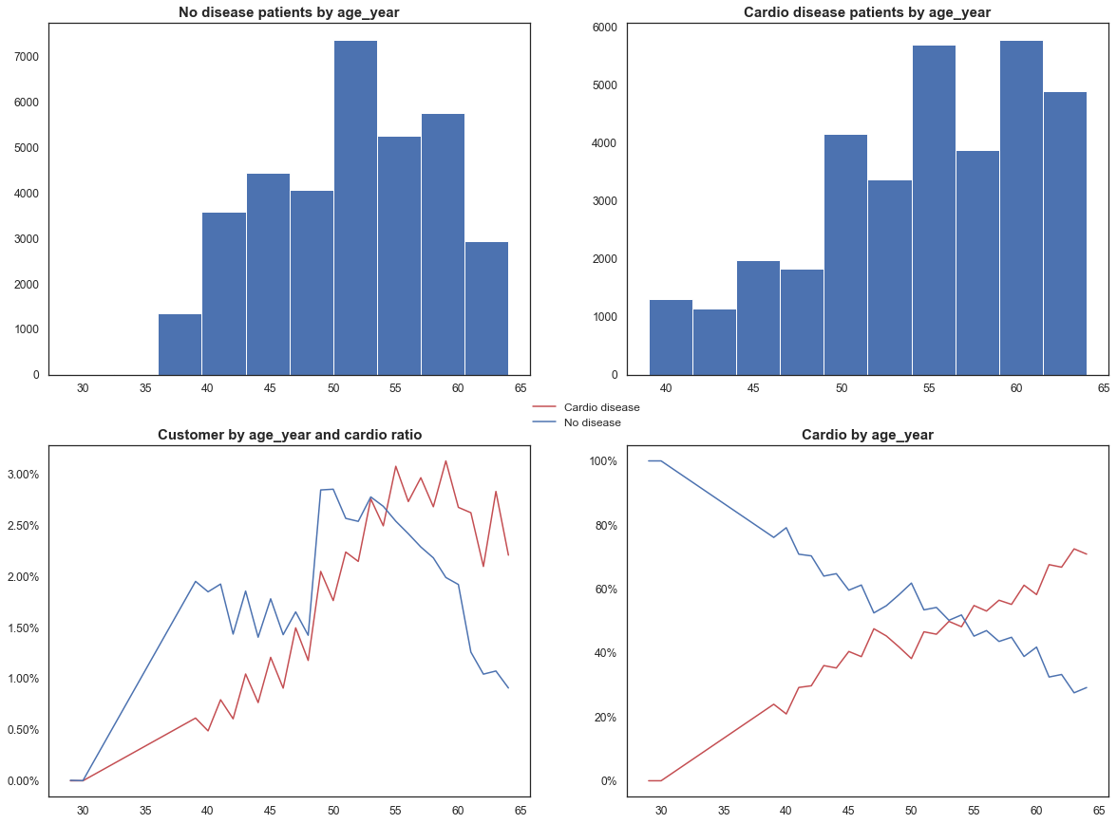

Slide 23

Gender

Slide 24
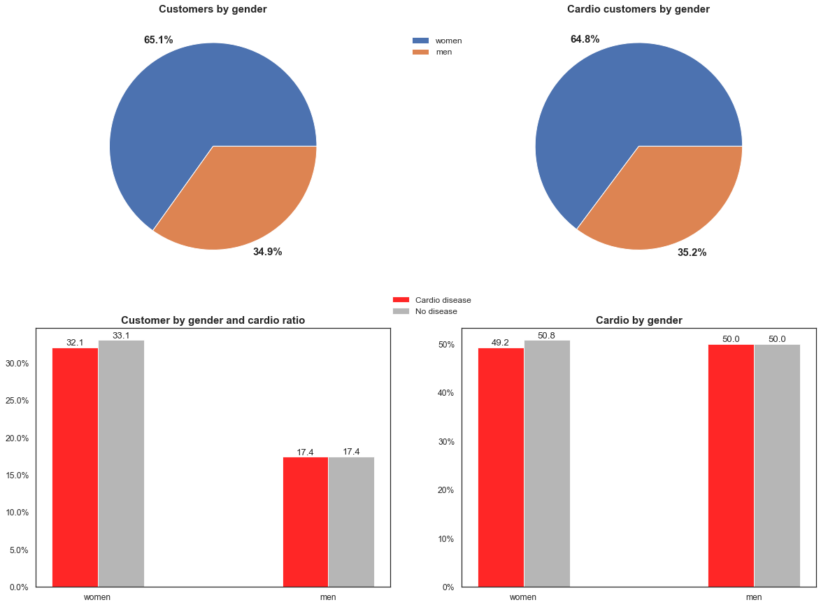

Slide 25

Alcohol

Slide 26
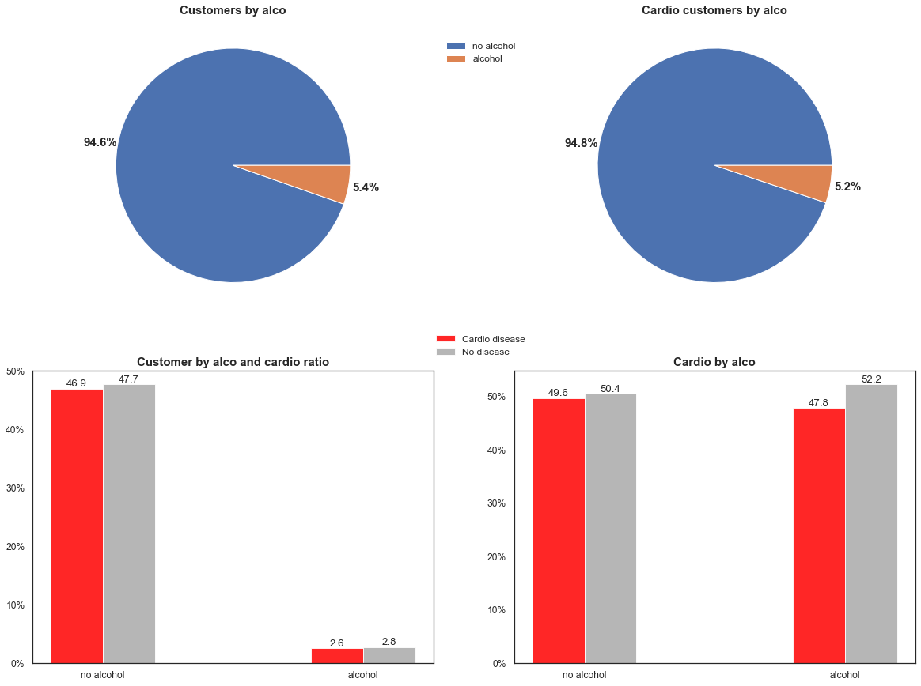

Slide 27
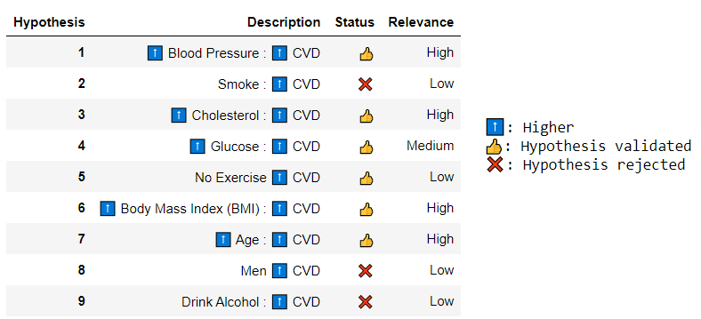
Hypotheses Overview

Slide 28
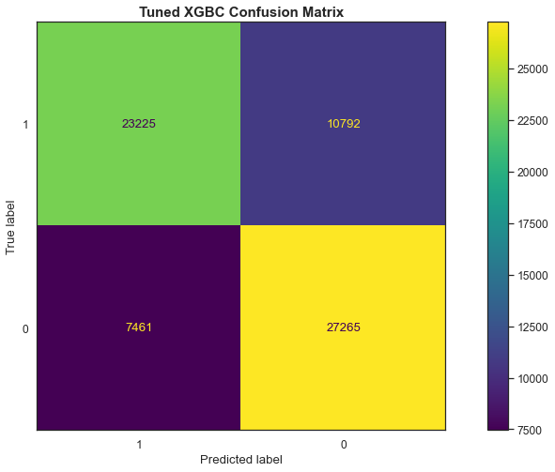
CVD Prediction Model
XGBoost Classifier Model:
Accuracy: 73.45%
Precision (Has CVD): 76.0%
Negative Precision (Doesn’t have CVD): 71.34%
Confusion Matrix Labels:
0: Doesn’t have CVD
1: Has CVD

Slide 29
Business Performance
Feature | Current Diagnoses | XGBoost Classifier Model (Distinct Precision) | XGBoost Classifier Model (Unique Precision)
Number of Diagnosis | 68,743 | 68,743 | 68,743
Precision | 60.00% | Has CVD: 76.00% Doesn’t have CVD: 71.34% | 73.45%
Cost | R$ 68,743,000.00 | R$ 68,743,000.00 | R$ 68,743,000.00
Revenue | R$ 68,663,000.00 | R$ 152,829,000.00 | R$ 137,486,000.00
Profit | - R$ 80,000.00 | R$ 84,086,000.00 | R$ 68,743,000.00
Profit Percentage | - 0.12% | 122.32% | 100.00%
Profit per Diagnosis | - R$ 1.16 | R$ 1,223.19 | R$ 1,000.00

Slide 30


Slide 31
Next Steps
Data
Model
Discount Solution
Collect more data and new features, like patient ethnicity and diet
Improve the precision of the prediction model
Create a method that optimizes the discount percentage choice to maximize the receipt and minimize the pending payment percentage

Slide 32
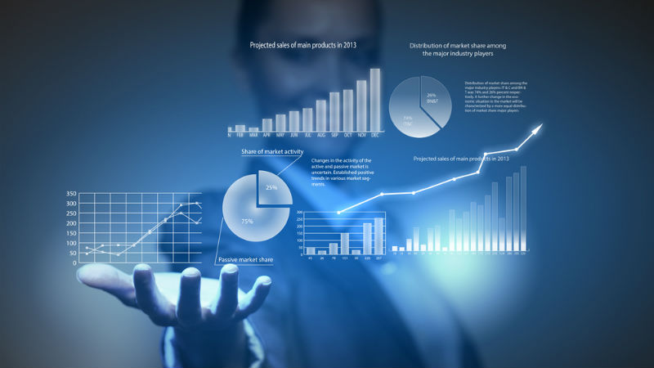

Data
Prediction Model
Collect more data and new features, like patient ethnicity and diet
Improve the precision of the prediction model

Slide 33



Henrique Issamu Umeda issamuumeda@gmail.com /henriqueissamu /henriqueumeda

